Slide 1



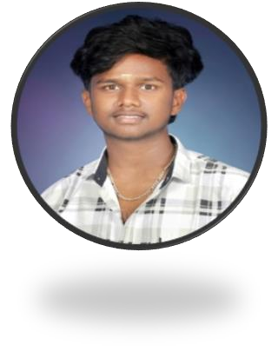

DIGITAL PORTFOLIO
NAME: JEETHAR.R
REGISTER NUMBER: 2422J1112
CLASS : II –BCA
NM ID: ASBRU062422J1112
DEPARTMENT: BACHELOR OF COMPUTER APPLICATION
COLLEGE NAME: CHIKKANNAGOVERNMENT ARTS COLLEGE
PLACE : TIRUPPUR.

Slide 2


TITLE
A journey through my software portfolio
Welcome to my world of code and creativity, where Ideas transform into impactful solutions.

Slide 3
CONTENTS
Problem Statement
Project Overview
End Users
Tools and Technologies
Portfolio design and Layout
Features and Functionality
Results and Screenshots
Conclusion
Github Link

Slide 4

PROBLEM STATEMENT
Outdated project Showcase.
Lack of customization options.
Inconsistent Branding.
Difficultly updating Content. Limited visibility online.
•

Slide 5

PROJECTOVERVIEW
Project goals and objectives.
Key features and functionalities.
Technologies and tools used.
Challenges overcome and solutions.
Outcomes and achievements.

Slide 6

END USERS
Potential employers.
Clients.
Collaborators.
Industry peers.
Recruiters.

Slide 7



TOOLS AND TECHNOLOGIES
Website builders (e.g. Wix, Squarespace)
Content management systems (e.g. WordPress)
Graphic design software (e.g. AdCorebaetive Cloud)
Version control systems (e.g. GitHub)
Website analytics tools (e.g. Google Analytics)

Slide 8
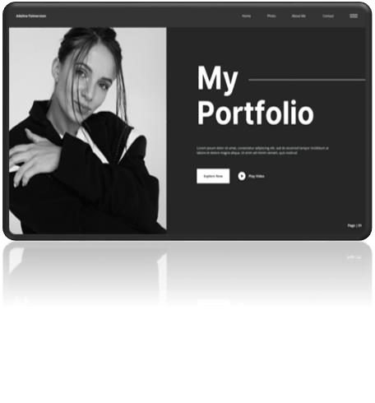
PORTFOLIO DESIGN AND LAYOUT
Clean and minimalistic design.
Consistent typography and color scheme. Easy navigation and clear categorization.
Prominent display of projects and achievements.
Responsive design for mobile and tablet.
•

Slide 9
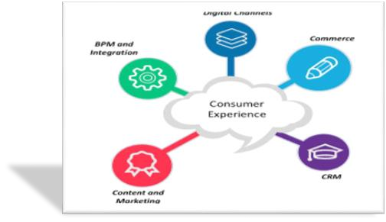
FEATURES AND FUNCTIONALITY
Project filtering and categorization. Image and video galleries.
Interactive demos and prototypes.
Downloadable resume and documents Contact form and social media integr n.
•
•

Slide 10

RESULTS AND SCREENSHOTS
Visual proof of accomplishments.
Showcase project outcomes.
Demonstrate design and development skills.
Highlight key features and functionalities. Provide context for user experience.
•
•

Slide 11
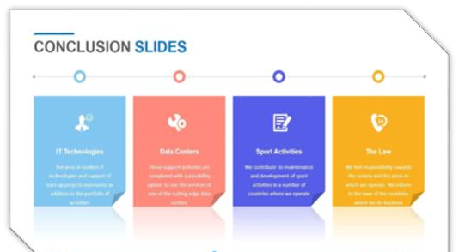
CONCLUSION
Summarize key accomplishments.
Reiterate professional goals. Encourage contact and collaboration.
Provide a clear call-to-action.
•
Leave a lasting impression.

Slide 12
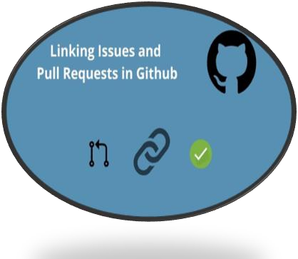
GITHUB LINK
GitHubRepository :(https://github.com/jeethar/Jeethar-
TNSDC-FWD-DP.git)
Email: jeatharjeathar@gmail.com
•
Phone:9361501852

Slide 13
THANK YOU

